Slide 1
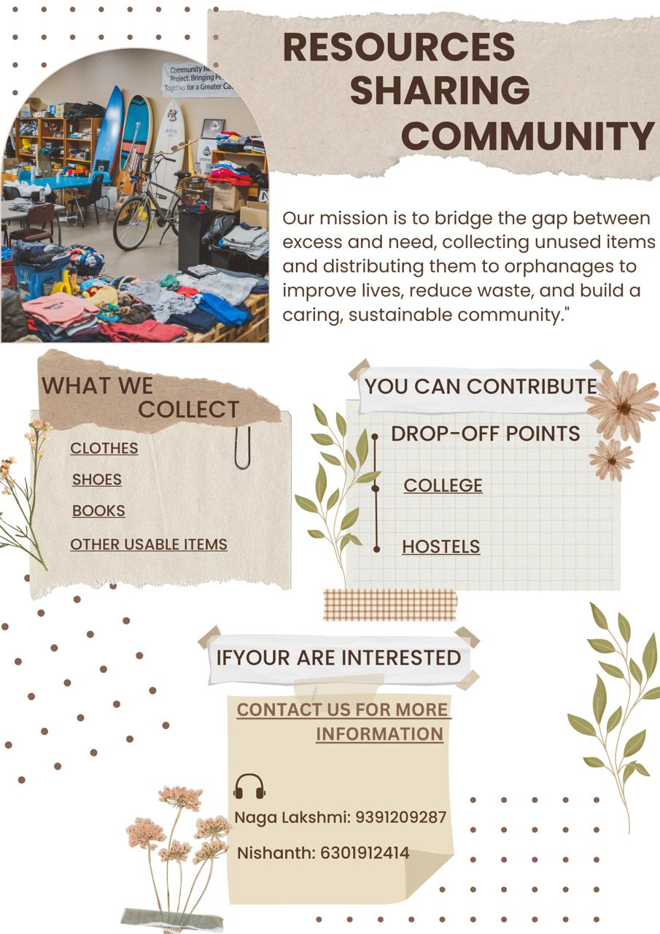


Compassion in Action: COMMUNITY RESOURCE SHARING

Slide 2
GROUP MEMBERS
DHARANI AM.SC.U4CSE24123
NISHANTH AM.SC.U4CSE24150
SRI CHARAN AM.SC.U4CSE24147
AVINASH AM.SC.U4CSE24171
PHANI SRI AM.SC.U4CSE24161
NAGA LAKSHMI AM.SC.U4CSE24140
SHARATH CHANDRA AM.SC.U4CSE24138
SHASHANK AM.SC.U4CSE24112
SANTHOSH AM.SC.U4CSE24122
SAI KIRAN AM.SC.U4CSE24126

Slide 3

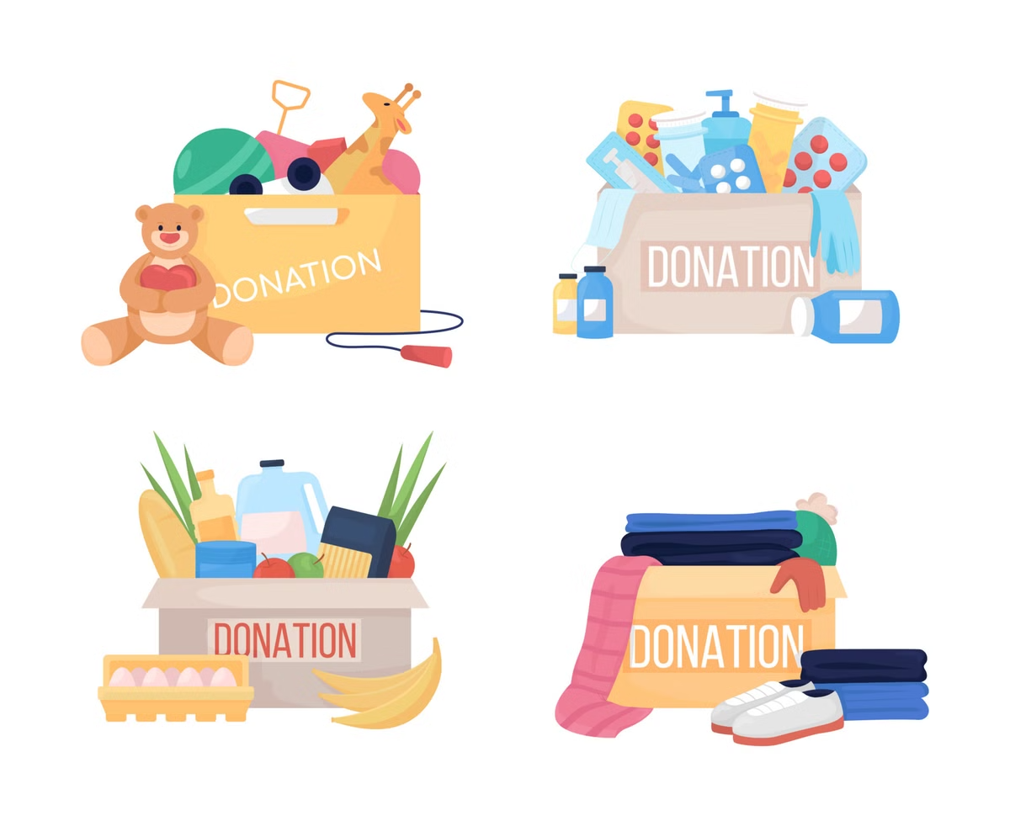
Our Project Goals
Collect Essential Items
Provide Essential Resources
Collect and donate clothes, toys, books, and other useful items to an orphanage.
Clothes, books, toys
Cultivate a Culture of Giving
Encourage students to contribute unused
items to support those in need.

Slide 4

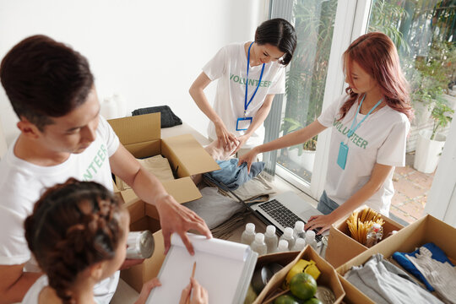
The Collection Process
1
Initial Announcement
Spread the word to everyone. We spread the message through
social media groups and pamphlets
2
Collection Points
Designated locations for donations
3
Timeline for Collection
Duration of the drive

Slide 5

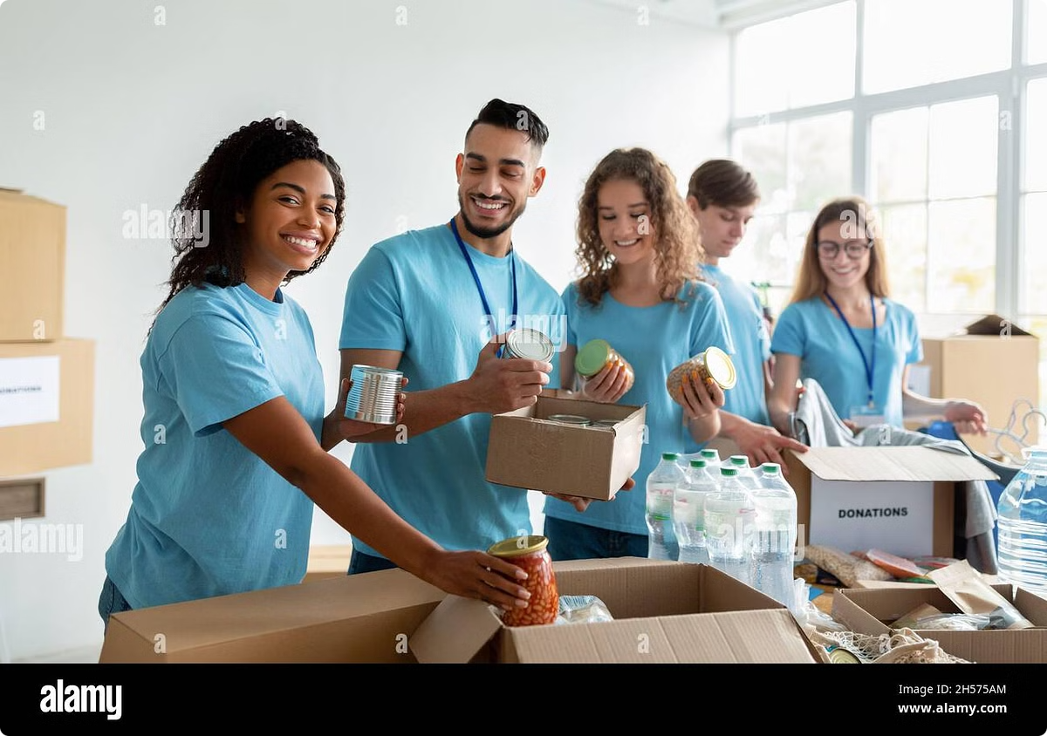



Sorting and Preparing Donations
Categorizing Items
Clothes, books, toys
Assessing Condition
Ensure items are usable
Cleaning and Packaging
Readying donations for delivery

Slide 6




Donation Day at the Orphanage
1
Arrival and Welcome
2
Interactive Activities
3
Donation Presentation
4
Sharing and Laughter

Slide 7
Challenges and Solutions
Time Constraints
Balancing the project with academic schedules was difficult.
1
Engagement
2
Motivating students to participate
Timeline
3
Meeting deadlines

Slide 8
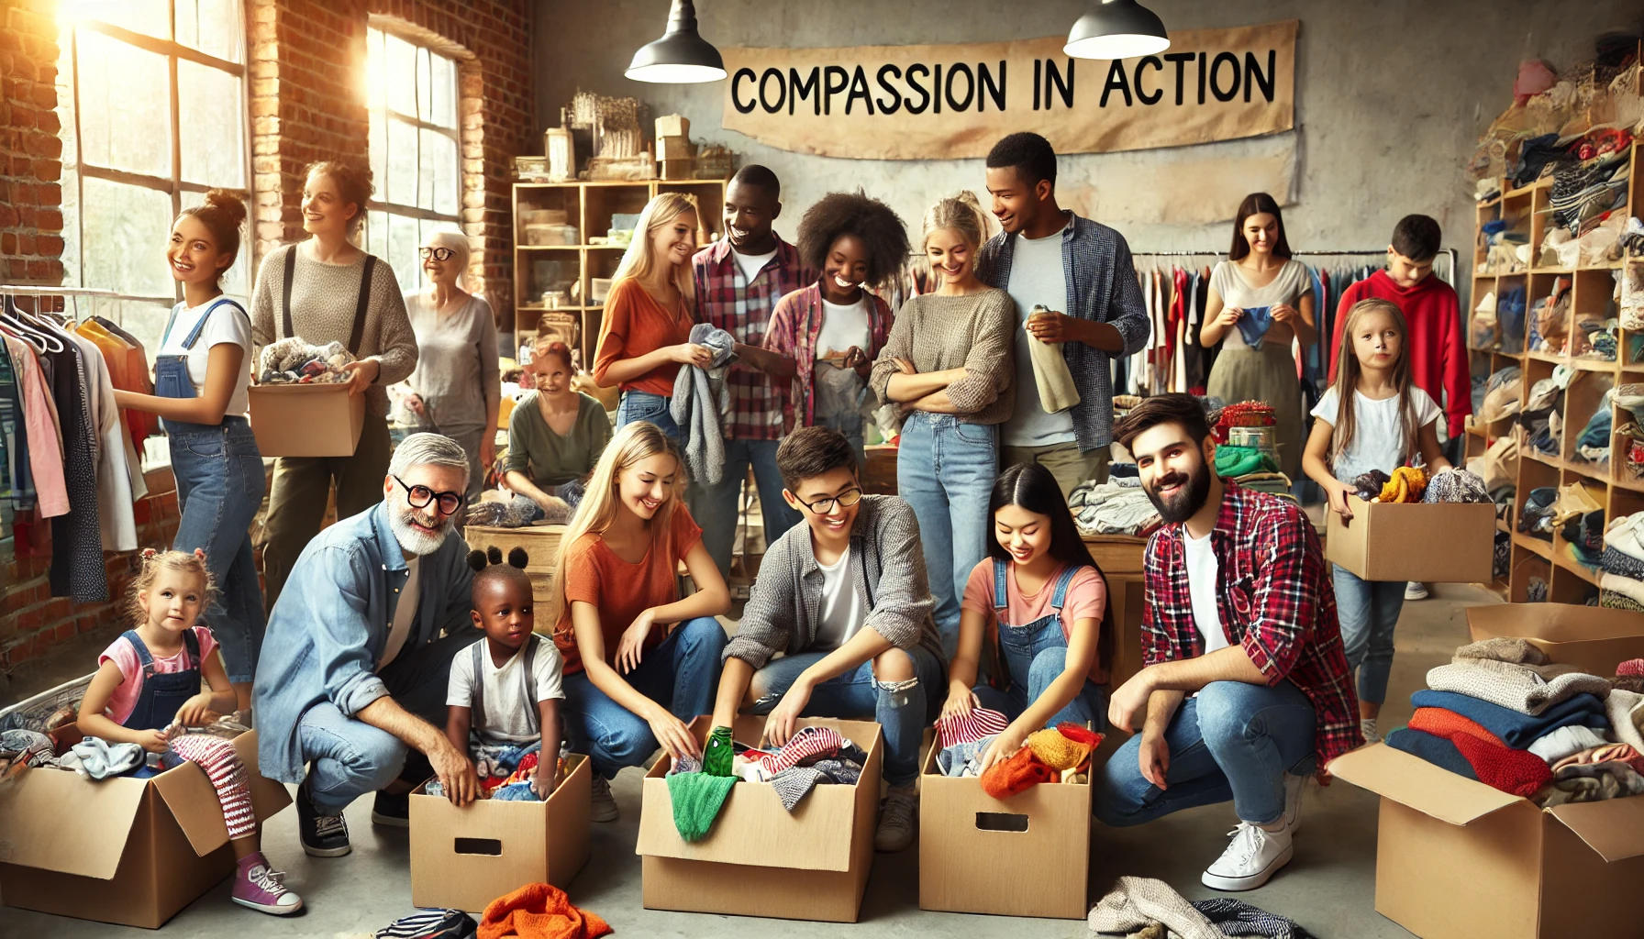




Group Reflection
Teamwork
Collaboration and support
Learning
Gaining valuable experiences
Compassion
Witnessing the impact of our work

Slide 9


Future Initiatives
We aim to cultivate a mindset where unused
items are seen as valuable resources that can
bring joy and comfort to those in need. By
encouraging students to donate these items to
orphanages, we not only reduce waste but also
Foster compassion and a sense of social responsibility.

